Slide 1

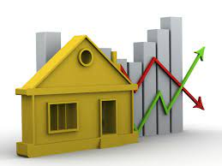
Housing Price Prediction
By
Gargi Saha Samanta

Slide 2
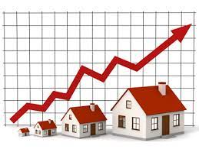
Content
Problem Statement
Data Summary
Exploratory Data Analysis
Univariate Analysis of Categorical Variables and its observations
Bivariate Analysis of Categorical Variables and its observations
Univariate Analysis of Numerical Variables and its observations
Bivariate Analysis of Numerical Variables and its observations
Outliers
Data Preprocessing
Model Building with Regression techniques
Hypertuning the Best Model
Conclusion

Slide 3
Problem Statement
We are required to model the price of houses with the available independent variables. This model will then be used by the management to understand how exactly the prices vary with the variables. They can accordingly manipulate the strategy of the firm and concentrate on areas that will yield high returns. Further, the model will be a good way for the management to understand the pricing dynamics of a new market.
The company is looking at prospective properties to buy houses to enter the market. We are required to build a model using Machine Learning in order to predict the actual value of the prospective properties and decide whether to invest in them or not. For this ,company wants to know: • Which variables are important to predict the price of variable? • How do these variables describe the price of the house?

Slide 4

Data Summary
MSSubClass: Identifies the type of dwelling involved in the sale.
20 1-STORY 1946 & NEWER ALL STYLES 30 1-STORY 1945 & OLDER 40 1-STORY W/FINISHED ATTIC ALL AGES 45 1-1/2 STORY - UNFINISHED ALL AGES 50 1-1/2 STORY FINISHED ALL AGES 60 2-STORY 1946 & NEWER 70 2-STORY 1945 & OLDER 75 2-1/2 STORY ALL AGES 80 SPLIT OR MULTI-LEVEL 85 SPLIT FOYER 90 DUPLEX - ALL STYLES AND AGES 120 1-STORY PUD (Planned Unit Development) - 1946 & NEWER 150 1-1/2 STORY PUD - ALL AGES 160 2-STORY PUD - 1946 & NEWER 180 PUD - MULTILEVEL - INCL SPLIT LEV/FOYER 190 2 FAMILY CONVERSION - ALL STYLES AND AGES
MSZoning: Identifies the general zoning classification of the sale.
A Agriculture C Commercial FV Floating Village Residential I Industrial RH Residential High Density RL Residential Low Density RP Residential Low Density Park RM Residential Medium Density
LotFrontage: Linear feet of street connected to property
LotArea: Lot size in square feet
Street: Type of road access to property
Grvl Gravel Pave Paved
Alley: Type of alley access to property
Grvl Gravel Pave Paved NA No alley access
LotShape: General shape of property
Reg Regular IR1 Slightly irregular IR2 Moderately Irregular IR3 Irregular
LandContour: Flatness of the property
Lvl Near Flat/Level Bnk Banked - Quick and significant rise from street grade to building HLS Hillside - Significant slope from side to side Low Depression

Slide 5
Data Summary
Utilities: Type of utilities available
AllPub All public Utilities (E,G,W,& S) NoSewr Electricity, Gas, and Water (Septic Tank)
NoSeWa Electricity and Gas Only ELO Electricity only
LotConfig: Lot configuration
Inside Inside lot Corner Corner lot CulDSac Cul-de-sac FR2 Frontage on 2 sides of property FR3
Frontage on 3 sides of property
LandSlope: Slope of property
Gtl Gentle slope Mod Moderate Slope Sev Severe Slope
Neighborhood: Physical locations within Ames city limits
Blmngtn Bloomington Heights
Blueste Bluestem
BrDale Briardale
BrkSide Brookside
ClearCr Clear Creek
CollgCr College Creek
Crawfor Crawford
Edwards Edwards
Gilbert Gilbert
IDOTRR Iowa DOT and Rail Road
MeadowV Meadow Village
Mitchel Mitchell
Names North Ames
NoRidge Northridge
NPkVill Northpark Villa
NridgHt Northridge Heights
NWAmes Northwest Ames
OldTown Old Town
SWISU South & West of Iowa State University
Sawyer Sawyer
SawyerW Sawyer West
Somerst Somerset
StoneBr Stone Brook
Timber Timberland
Veenker Veenker

Slide 6
Data Summary
Condition1: Proximity to various conditions
Artery Adjacent to arterial street
Feedr Adjacent to feeder street
Norm Normal
RRNn Within 200' of North-South Railroad
RRAn Adjacent to North-South Railroad
PosN Near positive off-site feature--park, greenbelt, etc.
PosA Adjacent to postive off-site feature
RRNe Within 200' of East-West Railroad
RRAe Adjacent to East-West Railroad
Condition2: Proximity to various conditions (if more than one is present)
Artery Adjacent to arterial street
Feedr Adjacent to feeder street
Norm Normal
RRNn Within 200' of North-South Railroad
RRAn Adjacent to North-South Railroad
PosN Near positive off-site feature--park, greenbelt, etc.
PosA Adjacent to postive off-site feature
RRNe Within 200' of East-West Railroad
RRAe Adjacent to East-West Railroad

Slide 7
Data Summary
BldgType: Type of dwelling
1Fam Single-family Detached
2FmCon Two-family Conversion; originally built as one-family dwelling
Duplx Duplex
TwnhsE Townhouse End Unit
TwnhsI Townhouse Inside Unit
HouseStyle: Style of dwelling
1Story One story
1.5Fin One and one-half story: 2nd level finished
1.5Unf One and one-half story: 2nd level unfinished
2Story Two story
2.5Fin Two and one-half story: 2nd level finished
2.5Unf Two and one-half story: 2nd level unfinished
SFoyer Split Foyer
SLvl Split Level
OverallQual: Rates the overall material and finish of the house
10 Very Excellent 9 Excellent
8 Very Good 7 Good
6 Above Average 5 Average
4 Below Average 3 Fair
2 Poor 1 Very Poor

Slide 8
Data Summary
OverallCond: Rates the overall condition of the house
10 Very Excellent 9 Excellent
8 Very Good 7 Good
6 Above Average 5 Average
4 Below Average 3 Fair
2 Poor 1 Very Poor
YearBuilt: Original construction date
YearRemodAdd: Remodel date (same as construction date if no remodeling or additions)
RoofStyle: Type of roof
Flat Flat
Gable Gable
Gambrel Gabrel (Barn)
Hip Hip
Mansard Mansard
Shed Shed
RoofMatl: Roof material
ClyTile Clay or Tile
CompShg Standard (Composite) Shingle
Membran Membrane
Metal Metal
Roll Roll
Tar&Grv Gravel & Tar
WdShake Wood Shakes
WdShngl Wood Shingles

Slide 9
Data Summary
Exterior1st: Exterior covering on house
AsbShng Asbestos Shingles
AsphShn Asphalt Shingles
BrkComm Brick Common
BrkFace Brick Face
CBlock Cinder Block
CemntBd Cement Board
HdBoard Hard Board
ImStucc Imitation Stucco
MetalSd Metal Siding
Other Other
Plywood Plywood
PreCast PreCast
Stone Stone
Stucco Stucco
VinylSd Vinyl Siding
Wd Sdng Wood Siding
WdShing Wood Shingles
Exterior2nd: Exterior covering on house (if more than one material)
AsbShng Asbestos Shingles AsphShn Asphalt Shingles
BrkComm Brick Common BrkFace Brick Face
CBlock Cinder Block CemntBd Cement Board
HdBoard Hard Board ImStucc Imitation Stucco
MetalSd Metal Siding Other Other
Plywood Plywood PreCast PreCast
Stone Stone Stucco Stucco
VinylSd Vinyl Siding Wd Sdng Wood Siding
WdShing Wood Shingles

Slide 10
Data Summary
MasVnrType: Masonry veneer type
BrkCmn Brick Common
BrkFace Brick Face
CBlock Cinder Block
None None
Stone Stone
MasVnrArea: Masonry veneer area in square feet
ExterQual: Evaluates the quality of the material on the exterior
Ex Excellent
Gd Good
TA Average/Typical
Fa Fair
Po Poor
ExterCond: Evaluates the present condition of the material on the exterior
Ex Excellent
Gd Good
TA Average/Typical
Fa Fair
Po Poor
Foundation: Type of foundation
BrkTil Brick & Tile
CBlock Cinder Block
PConc Poured Contrete
Slab Slab
Stone Stone
Wood Wood

Slide 11
Data Summary
BsmtQual: Evaluates the height of the basement
Ex Excellent (100+ inches)
Gd Good (90-99 inches)
TA Typical (80-89 inches)
Fa Fair (70-79 inches)
Po Poor (<70 inches
NA No Basement
BsmtCond: Evaluates the general condition of the basement
Ex Excellent
Gd Good
TA Typical - slight dampness allowed
Fa Fair - dampness or some cracking or settling
Po Poor - Severe cracking, settling, or wetness
NA No Basement
BsmtExposure: Refers to walkout or garden level walls
Gd Good Exposure
Av Average Exposure (split levels or foyers typically score average or above)
Mn Mimimum Exposure
No No Exposure
NA No Basement
BsmtFinType1: Rating of basement finished area
GLQ Good Living Quarters
ALQ Average Living Quarters
BLQ Below Average Living Quarters
Rec Average Rec Room
LwQ Low Quality
Unf Unfinshed
NA No Basement

Slide 12
Data Summary
BsmtFinSF1: Type 1 finished square feet
BsmtFinType2: Rating of basement finished area (if multiple types)
GLQ Good Living Quarters
ALQ Average Living Quarters
BLQ Below Average Living Quarters
Rec Average Rec Room
LwQ Low Quality
Unf Unfinshed
NA No Basement
BsmtFinSF2: Type 2 finished square feet
BsmtUnfSF: Unfinished square feet of basement area
TotalBsmtSF: Total square feet of basement area
Heating: Type of heating
Floor Floor Furnace
GasA Gas forced warm air furnace
GasW Gas hot water or steam heat
Grav Gravity furnace
OthW Hot water or steam heat other than gas
Wall Wall furnace
HeatingQC: Heating quality and condition
Ex Excellent
Gd Good
TA Average/Typical
Fa Fair
Po Poor

Slide 13
Data Summary
CentralAir: Central air conditioning
N No
Y Yes
Electrical: Electrical system
SBrkr Standard Circuit Breakers & Romex
FuseA Fuse Box over 60 AMP and all Romex wiring (Average)
FuseF 60 AMP Fuse Box and mostly Romex wiring (Fair)
FuseP 60 AMP Fuse Box and mostly knob & tube wiring (poor)
Mix Mixed
1stFlrSF: First Floor square feet
2ndFlrSF: Second floor square feet
LowQualFinSF: Low quality finished square feet (all floors)
GrLivArea: Above grade (ground) living area square feet
BsmtFullBath: Basement full bathrooms
BsmtHalfBath: Basement half bathrooms
FullBath: Full bathrooms above grade
HalfBath: Half baths above grade
Bedroom: Bedrooms above grade (does NOT include basement bedrooms)
Kitchen: Kitchens above grade
KitchenQual: Kitchen quality
Ex Excellent
Gd Good
TA Typical/Average
Fa Fair
Po Poor

Slide 14
Data Summary
TotRmsAbvGrd: Total rooms above grade (does not include bathrooms)
Functional: Home functionality (Assume typical unless deductions are warranted)
Typ Typical Functionality
Min1 Minor Deductions 1
Min2 Minor Deductions 2
Mod Moderate Deductions
Maj1 Major Deductions 1
Maj2 Major Deductions 2
Sev Severely Damaged
Sal Salvage only
Fireplaces: Number of fireplaces
FireplaceQu: Fireplace quality
Ex Excellent - Exceptional Masonry Fireplace
Gd Good - Masonry Fireplace in main level
TA Average - Prefabricated Fireplace in main living area or Masonry Fireplace in basement
Fa Fair - Prefabricated Fireplace in basement
Po Poor - Ben Franklin Stove
NA No Fireplace
GarageType: Garage location
2Types More than one type of garage
Attchd Attached to home
Basment Basement Garage
BuiltIn Built-In (Garage part of house - typically has room above garage)
CarPort Car Port
Detchd Detached from home
NA No Garage
GarageYrBlt: Year garage was built
GarageFinish: Interior finish of the garage
Fin Finished
RFn Rough Finished
Unf Unfinished
NA No Garage

Slide 15
Data Summary
GarageCars: Size of garage in car capacity
GarageArea: Size of garage in square feet
GarageQual: Garage quality
Ex Excellent
Gd Good
TA Typical/Average
Fa Fair
Po Poor
NA No Garage
GarageCond: Garage condition
Ex Excellent
Gd Good
TA Typical/Average
Fa Fair
Po Poor
NA No Garage
PavedDrive: Paved driveway
Y Paved
P Partial Pavement
N Dirt/Gravel
WoodDeckSF: Wood deck area in square feet
OpenPorchSF: Open porch area in square feet

Slide 16
Data Summary
EnclosedPorch: Enclosed porch area in square feet
3SsnPorch: Three season porch area in square feet
ScreenPorch: Screen porch area in square feet
PoolArea: Pool area in square feet
PoolQC: Pool quality
Ex Excellent
Gd Good
TA Average/Typical
Fa Fair
NA No Pool
Fence: Fence quality
GdPrv Good Privacy
MnPrv Minimum Privacy
GdWo Good Wood
MnWw Minimum Wood/Wire
NA No Fence
MiscFeature: Miscellaneous feature not covered in other categories
Elev Elevator
Gar2 2nd Garage (if not described in garage section)
Othr Other
Shed Shed (over 100 SF)
TenC Tennis Court
NA None
MiscVal: $Value of miscellaneous feature
MoSold: Month Sold (MM)
YrSold: Year Sold (YYYY)

Slide 17
Data Summary
SaleType: Type of sale
WD Warranty Deed - Conventional
CWD Warranty Deed - Cash
VWD Warranty Deed - VA Loan
New Home just constructed and sold
COD Court Officer Deed/Estate
Con Contract 15% Down payment regular terms
ConLw Contract Low Down payment and low interest
ConLI Contract Low Interest
ConLD Contract Low Down
Oth Other
SaleCondition: Condition of sale
Normal Normal Sale
Abnorml Abnormal Sale - trade, foreclosure, short sale
AdjLand Adjoining Land Purchase
Alloca Allocation - two linked properties with separate deeds, typically condo with a garage unit
Family Sale between family members
Partial Home was not completed when last assessed (associated with New Homes)

Slide 18

Exploratory Data Analysis ( EDA)

Slide 19
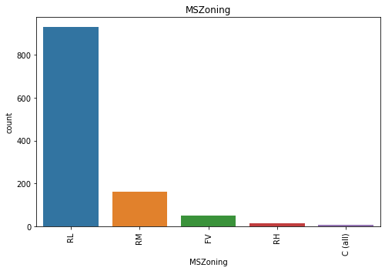
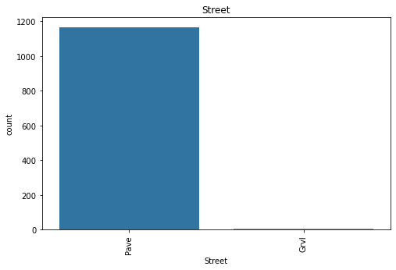
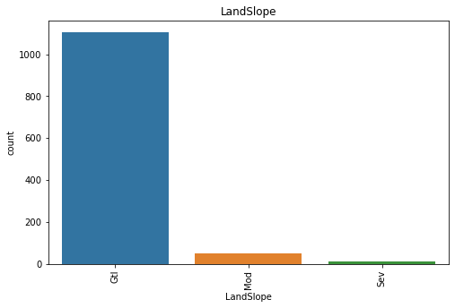
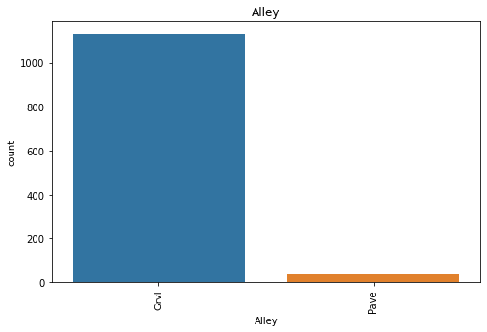
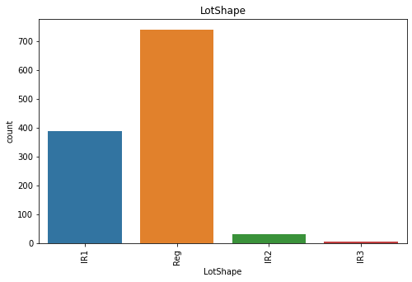
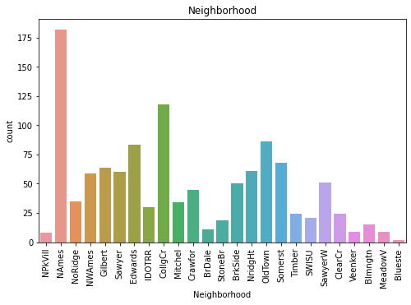
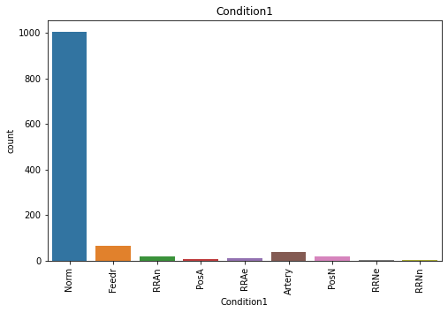
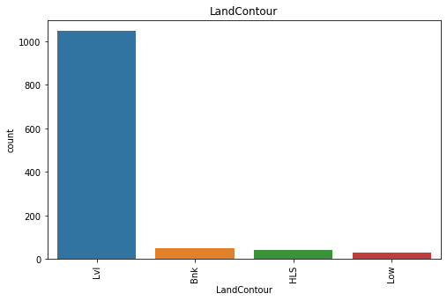
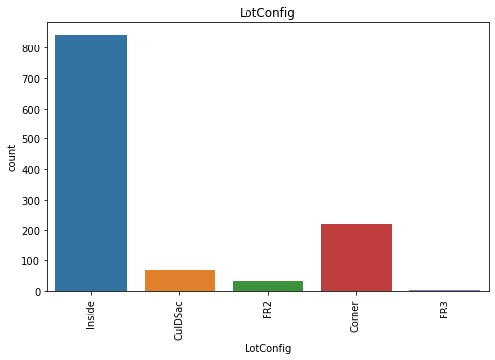
Univariate Analysis of categorical variables
Univariate Analysis of categorical variables:

Slide 20
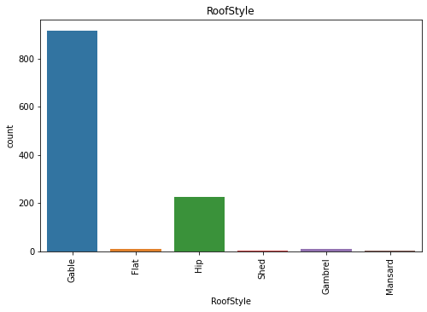
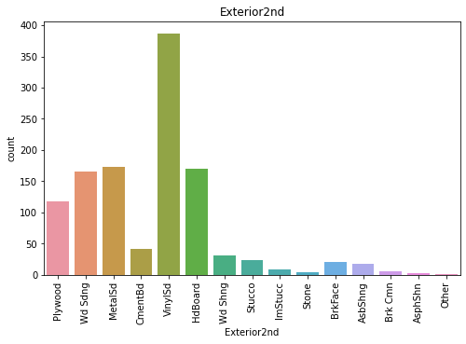
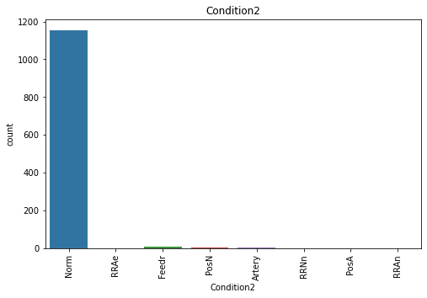
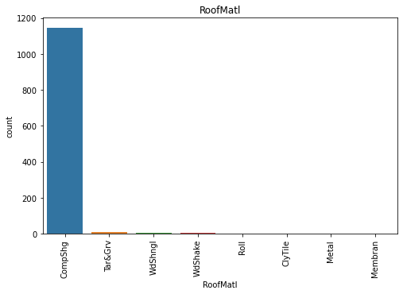
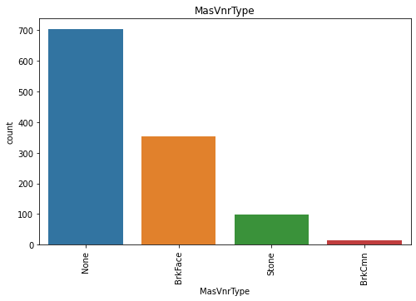
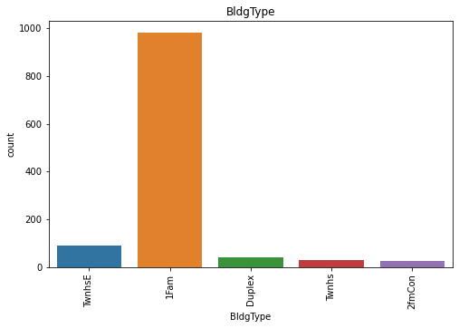
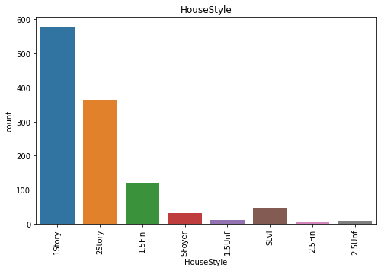
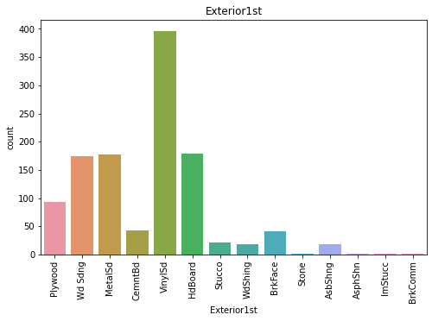
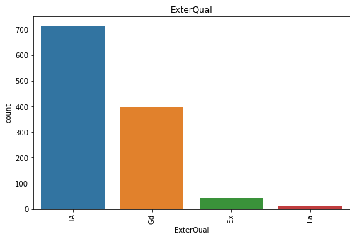
Univariate Analysis of categorical variables :

Slide 21
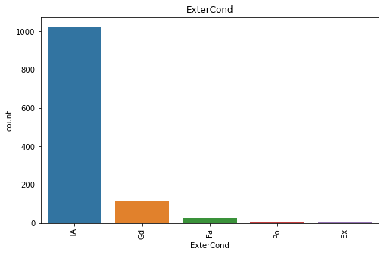
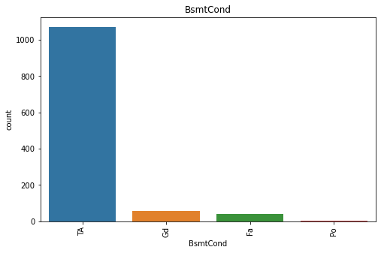
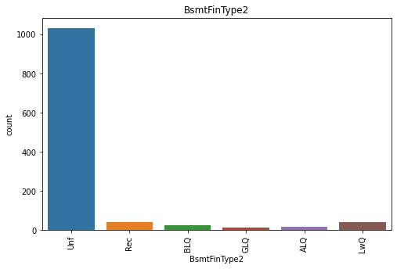
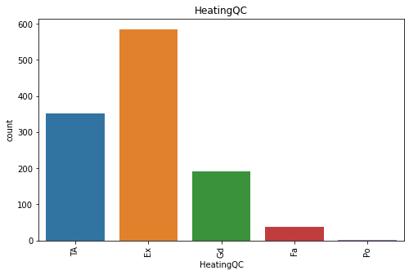
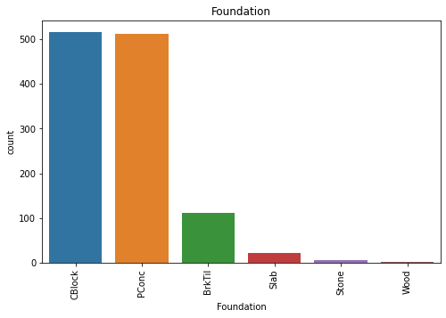
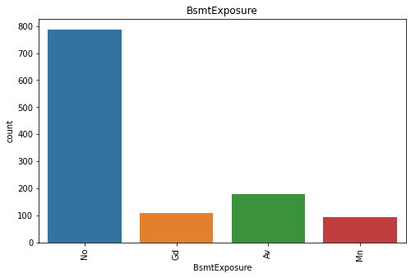
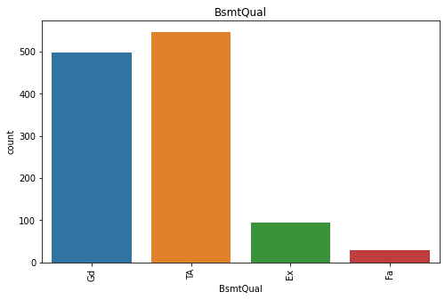
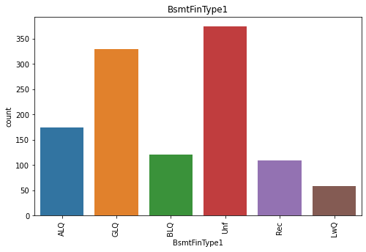
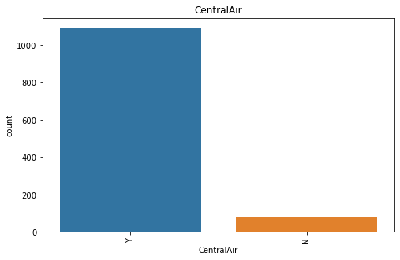
Univariate Analysis of categorical variables

Slide 22
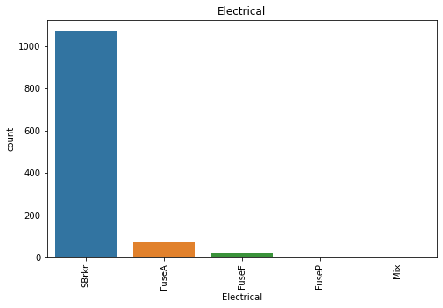
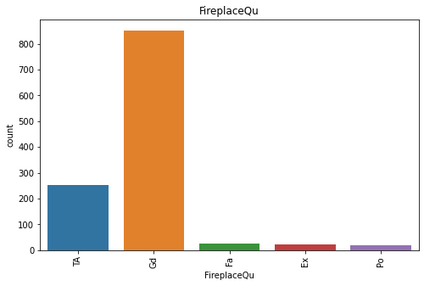
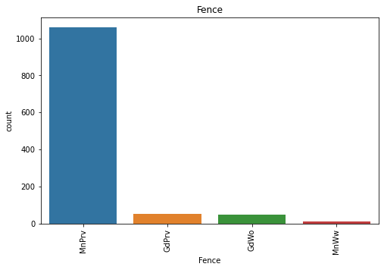
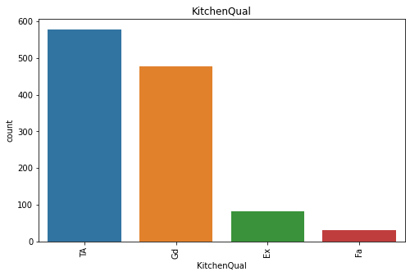
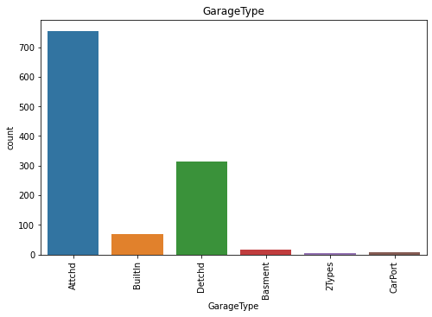
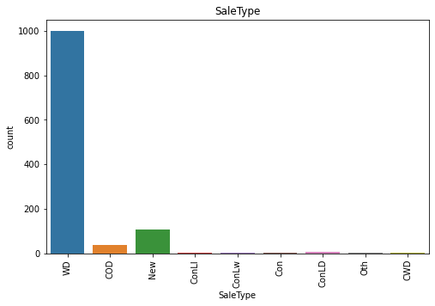
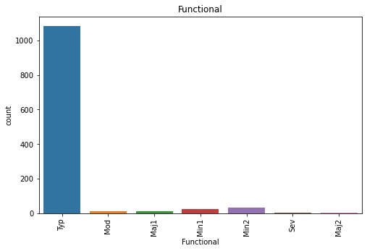
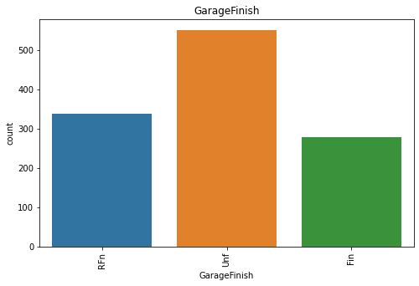
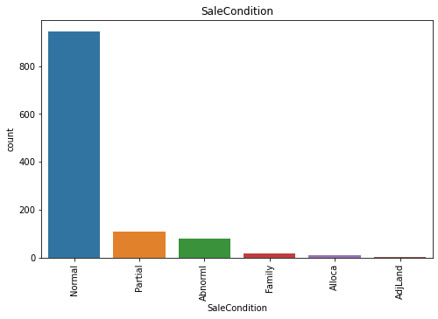
Univariate Analysis of categorical variables

Slide 23
Bi-variate plotting of categorical variables
OBSERVATION:
1. FV is highest in price followed by RL and RH.
2. Streets having Pave and Alley having Grvl is having high Price.
3. LotShape of IR2 is high in Price.
4. LandContour with HLS ,LotConfig with FR3,LandSlope woth Sev are having higher prices than the other subcategories.
5. Condition 1 withRRNn nad PosA have high price.
6. Condition2 with PonA follewd by PosN are having prices.
7. BldgType of Twnhse,HouseStyle of 2.5Unf,RoofStyle of Shed, RoofMatl of Wdshngl, Exterior1st of
stone and Imstucc are high prices whereas Exterior2nd with other and Imstucc have high price.
8. MasVnrType with stone, ExterQual with Ex,ExterCond withEx,Foundation with Pconc, BsmtQual with ex
BmstCond with Gd,BmstExposer with Gd,BsmtFinType1 with GQL,BsmtFinType2 with GQL andAQL are
high in Price.
9. Heating with GasA ,HeatingQc with Ex,CentralAir with Yes Electrical with SBrkr, KitchenQual with
Ex ,Funtional with Typ,FireplaceQu with Ex, GarageType with BuiltIn, GarageFinish with Fin has
high Price.
10. GarageQual with Ex,GarageCond with Gd,PavesDrive with Y,PoolQc with Ex ,Fence with MnPrv nad
GdPrv are high in Price.
11. SaleType of con and new ,SaleCondition with Partial are having highest SalePrice.

Slide 24
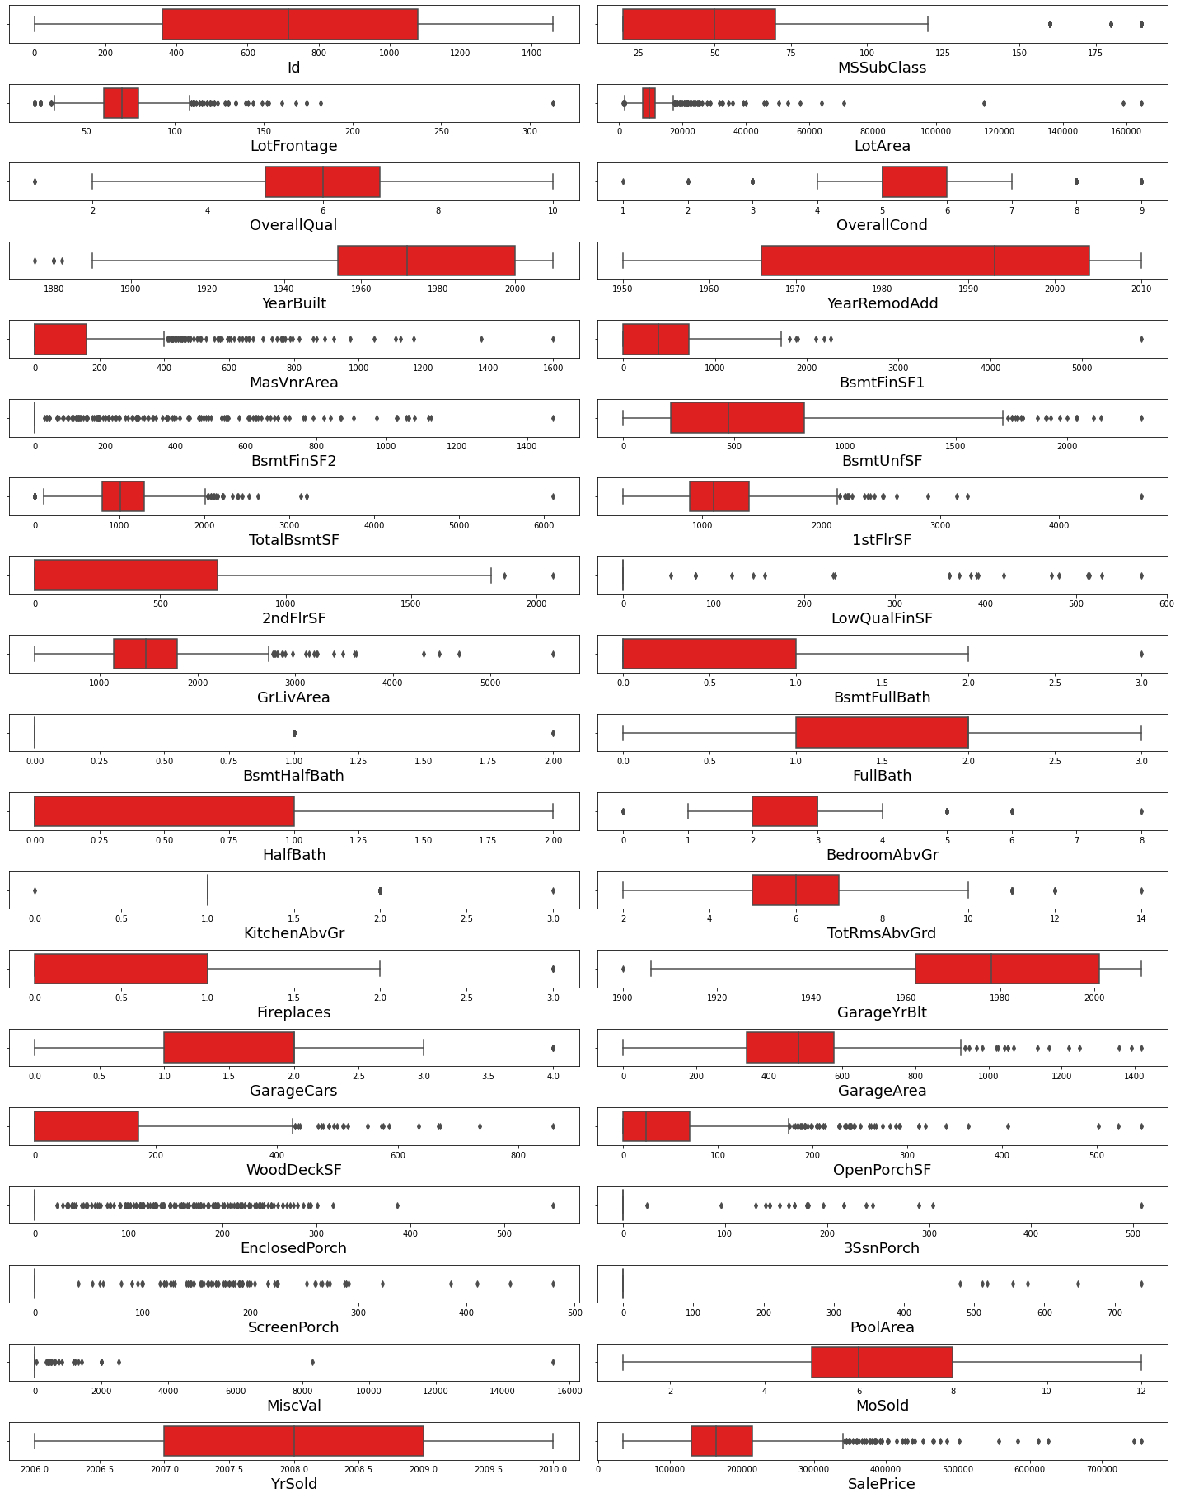
Univariate Analysis of Numerical variables
OBSERVATION:
1. Some features such as Id, YearRemodAdd,BsmFullBath,FullBath,HalfBathFirePlace,MoSold,YrSold are not having outliers.
2. Rest of the features are more or less having outliers .

Slide 25
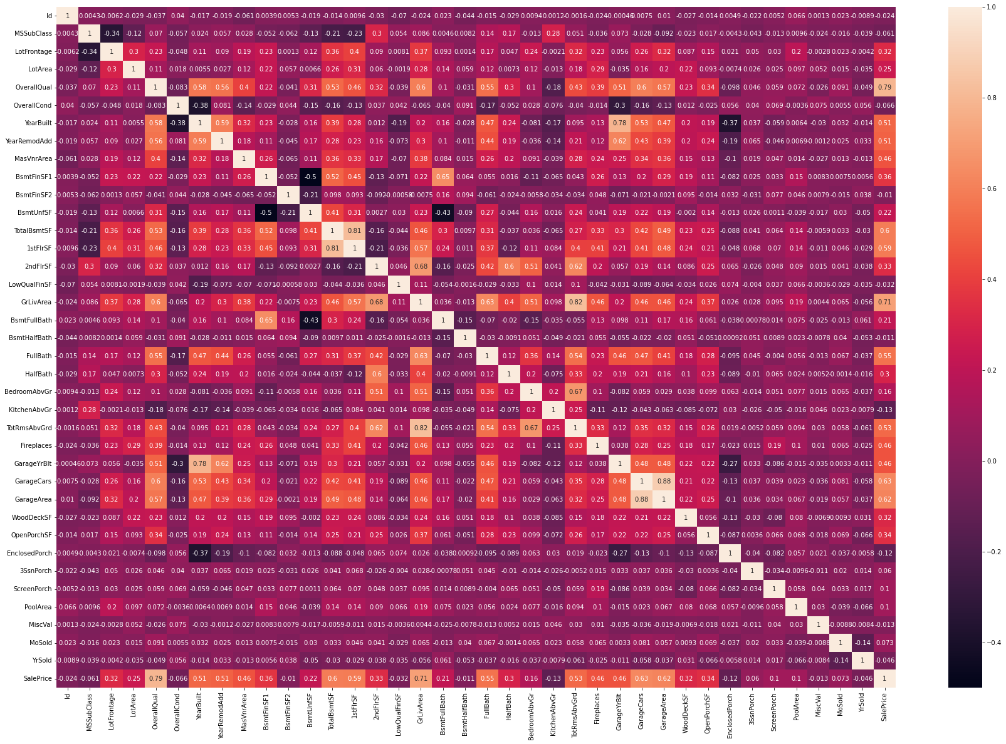
Correlation map:
Observation:
1. We can see that there is a positive correlation between the almost all the features and the SalePrice.
2. OFew of the features are showing strong relation but few are not.

Slide 26
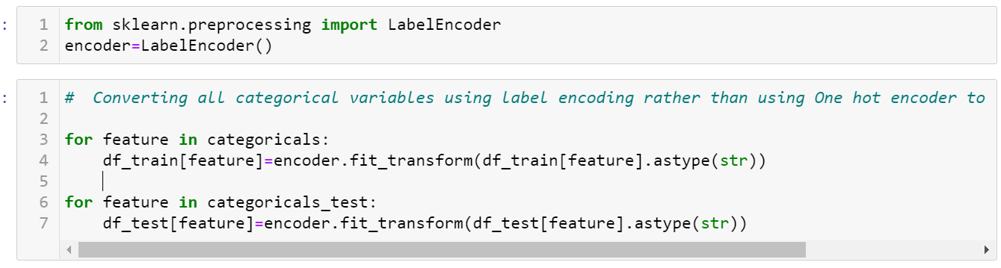
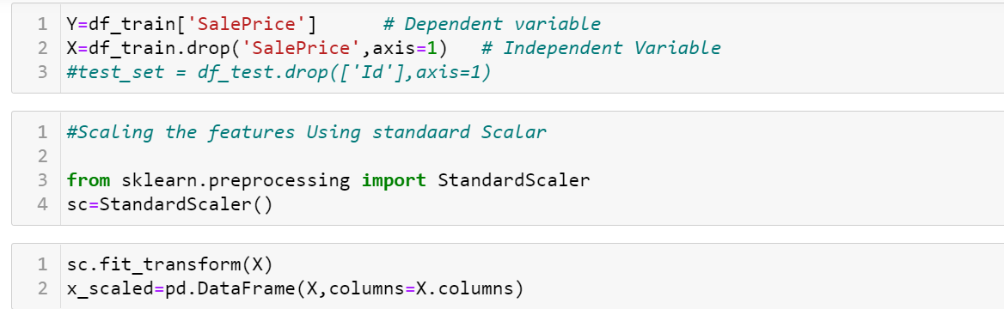
Data Preprocessing

Slide 27
Models used:
LinearRegression()
DecisionTreeRegressor()
KNeighborsRegressor()
RandomForestRegressor()
GradientBoostingRegressor()

Slide 28
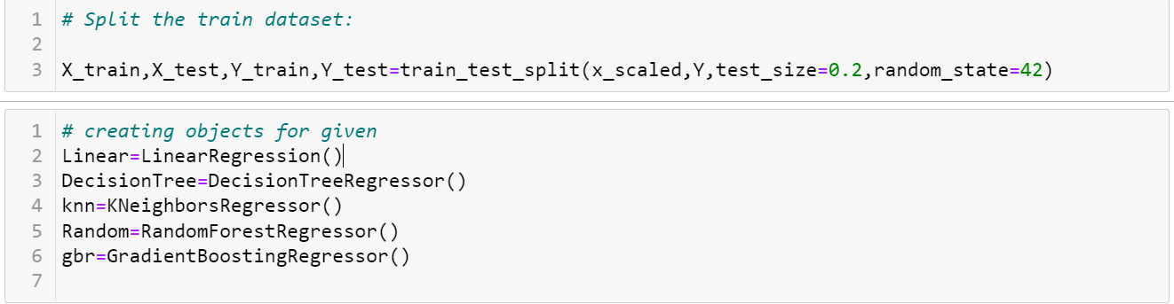
Model Building
From the dataset we can infer that it is clearly a regression problem.

Slide 29
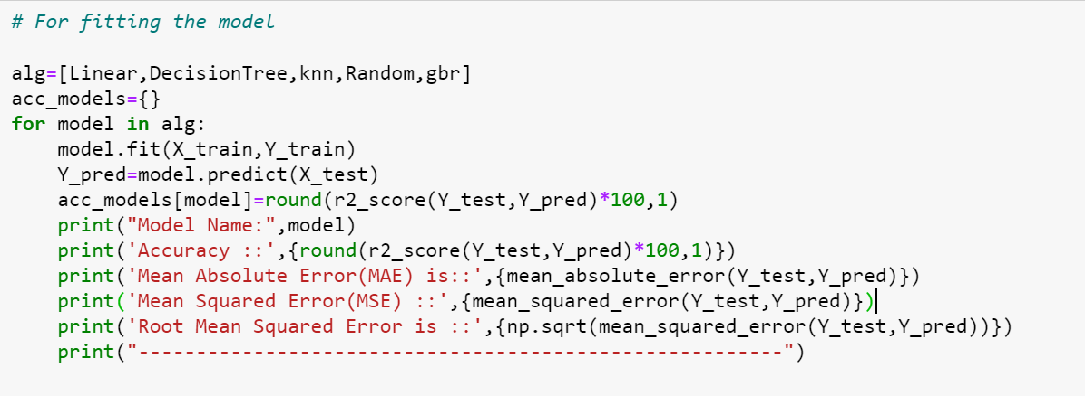
Fitting The Model

Slide 30
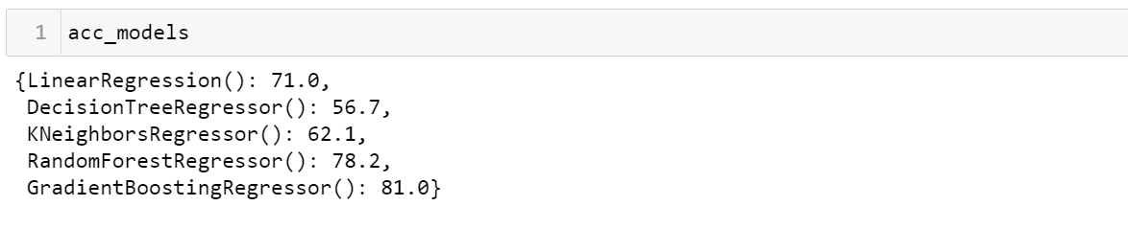
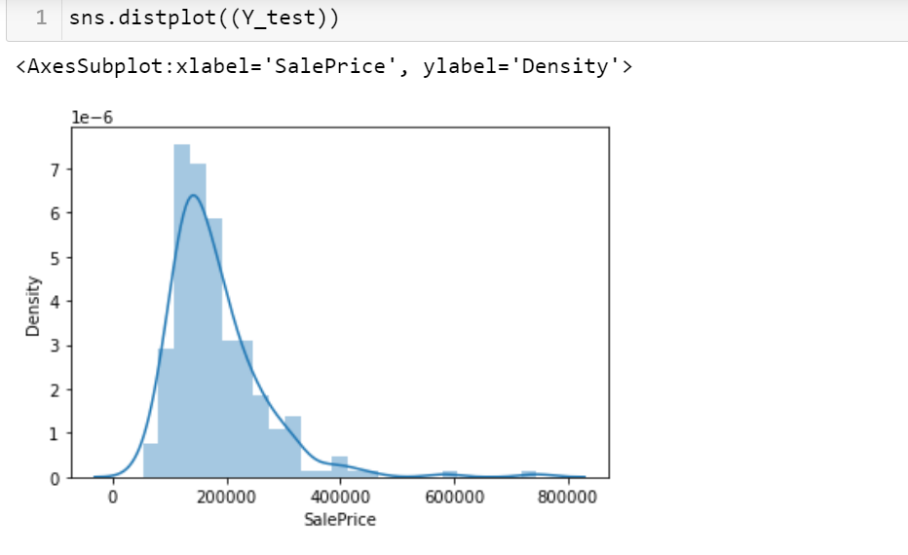
Accuracy of the Following Models

Slide 31
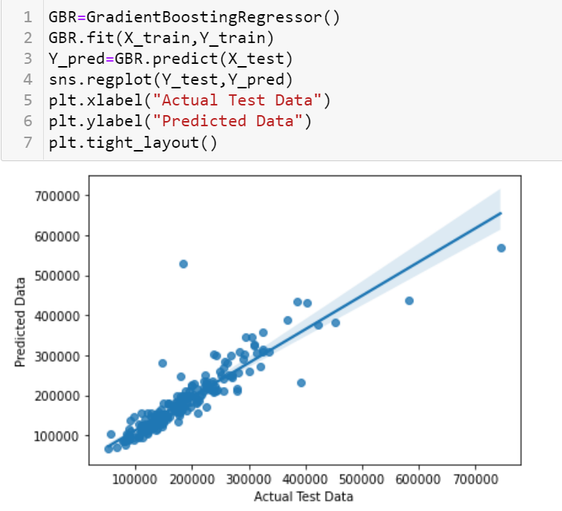
Graph After fitting the model

Slide 32
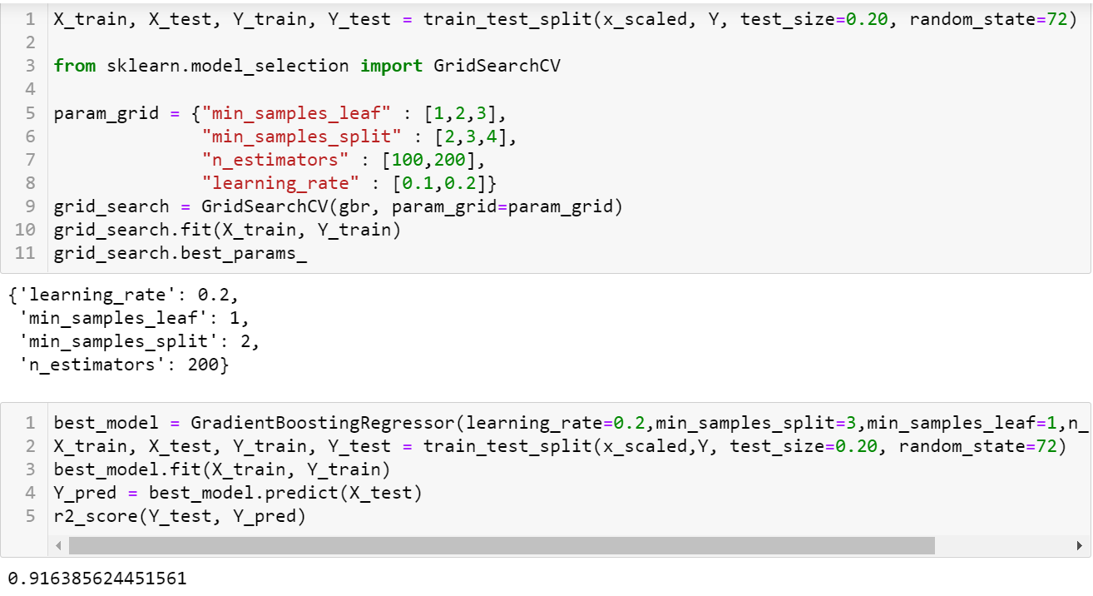
Hyperparameter Tuning the Model

Slide 33
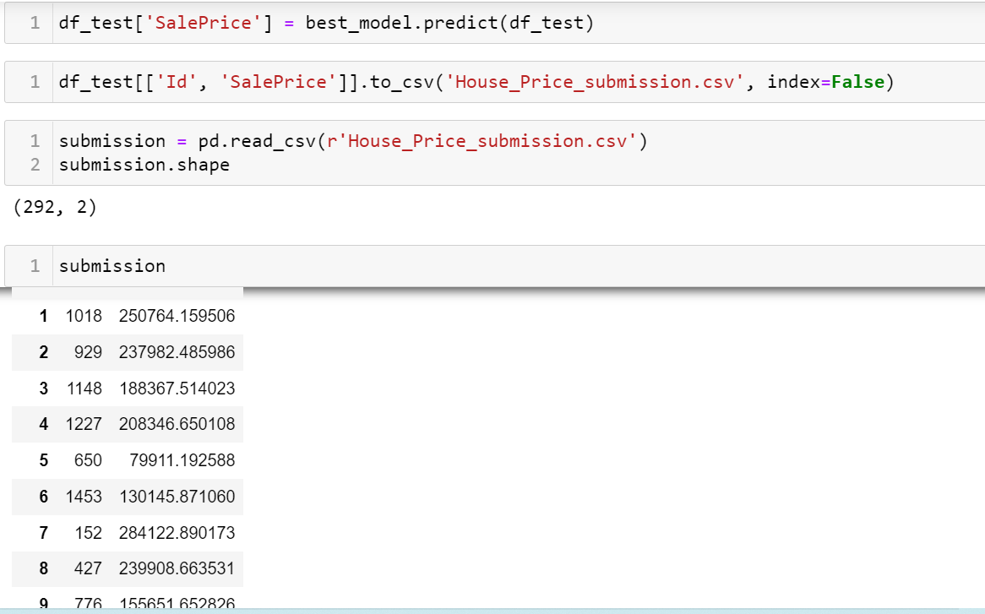
CONCLUSION
FINAL SUBMISSION:

Slide 34


